Slide 1
Unit 2
Distributed Storage Systems
Bhavika N. Patel

Slide 2
THE PROBLEM
A Single Machine Can't Keep Up
Traditional file systems work well on one computer with modest data volumes. Google, Facebook, Amazon, Netflix, and LinkedIn now generate volumes no single disk, or single machine, can hold or process fast enough.
1
2
3
~230 ZB
20 PB
90%
of data expected to be created worldwide in 2026
processed by Google every single day
of all existing global data was created in just the last two years
DesignRush, 2026
DigitalSilk research
Rivery, 2026
A Distributed File System (DFS) solves this by splitting files into blocks and spreading them across many networked machines, giving faster processing, high availability, fault tolerance, scalability, and cost-effective storage.

Slide 3
What is a Distributed File System?
DEFINITION
REAL-WORLD ANALOGY
A file storage system in which files are stored across multiple computers connected through a network, allowing users to access them as though they are stored on a single system.
The University Library
Science
Room
Arts
Room
Law
Room
Enables:
(middle room temporarily closed for maintenance)
Faster, parallel processing
Books are distributed across rooms by department, not piled in one room
High availability
Better fault tolerance
Students access different rooms simultaneously, without waiting in line
Scalability
Cost-effective storage
If one room closes, students still reach books in the other rooms

Slide 4
COMPARISON
Why Do We Need Distributed File Systems?
TRADITIONAL STORAGE
DISTRIBUTED STORAGE
Limited capacity
Virtually unlimited storage
Single point of failure
Multiple replicas ensure availability
Low scalability
Easily scalable
Slower processing
Parallel processing
Expensive upgrades
Commodity hardware can be added

Slide 5
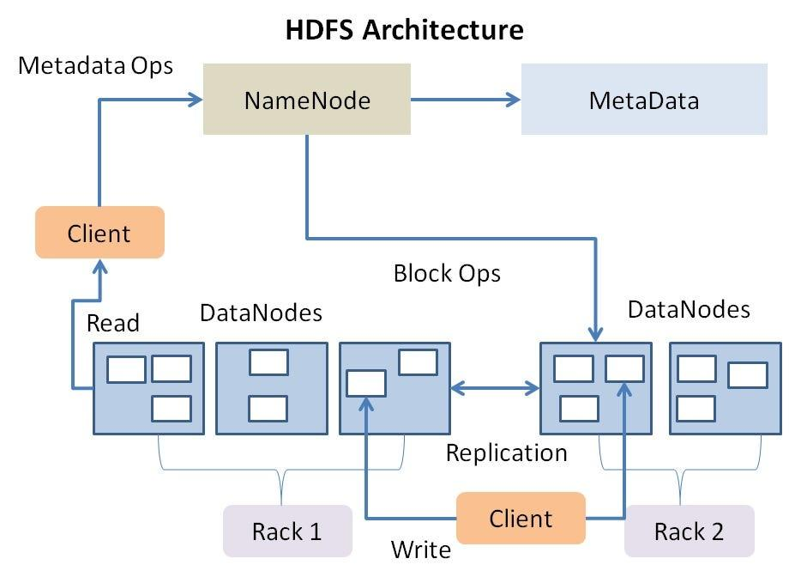
ARCHITECTURE
How a DFS Is Structured
USER
File System Interface
Master Server
(Metadata Management)
Storage Node 1
Storage Node 2
Storage Node 3
Block A
Block B
Block C

Slide 6
COMPONENTS
Three Building Blocks of a DFS
1
2
3
Client
Master Server
Storage Nodes
THE REQUESTER
THE COORDINATOR
THE WORKERS
Requests files and performs reads/writes against the file system interface — unaware of where blocks physically live.
Stores metadata only: file names, block locations, permissions, and replication details — never the file data itself.
Physically store the actual data blocks and serve them on request from the master server.
Called the NameNode in Hadoop
Called DataNodes in Hadoop
Notes:
Characteristics of Distributed File Systems
A good Distributed File System should provide:
✔ Scalability
✔ Reliability
✔ Fault Tolerance
✔ High Availability
✔ Data Locality
✔ Parallel Processing
✔ Replication
✔ Security

Slide 7
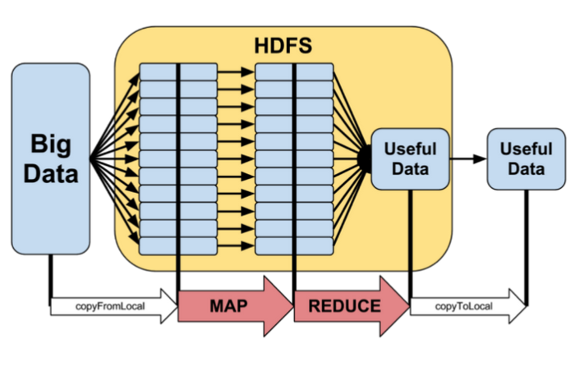
Parallelism in Distributed File Systems
Relies on distributing data blocks across a cluster and running computation tasks simultaneously on the nodes where the data lives.
Hadoop is designed to process large datasets by distributing them across multiple nodes in a cluster. This is achieved through the concept of parallelism, where data is divided into smaller chunks, known as data blocks, and processed concurrently on different nodes.
The parallel processing capability of Hadoop enhances the overall speed and efficiency of data processing tasks.
Notes:
Characteristics of Distributed File Systems
A good Distributed File System should provide:
✔ Scalability
✔ Reliability
✔ Fault Tolerance
✔ High Availability
✔ Data Locality
✔ Parallel Processing
✔ Replication
✔ Security

Slide 8
INTRODUCTION
What Is a Data Placement Strategy?
THE DECISION
GOOD PLACEMENT IMPROVES
When a new file is stored, the system must decide where each block should be stored.
✔
Availability
Data stays reachable even when individual nodes fail.
DEFINITION
✔
Speed
The method used by a distributed storage system to determine where data blocks and their replicas are stored across the cluster.
Blocks placed near consumers cut down read/write latency.
✔
Reliability
Spreading replicas protects against correlated failures.
✔
Load Balancing
Work is spread evenly instead of overloading a few nodes.

Slide 9
WHY IT MATTERS
What Happens When Placement Goes Wrong
Poor placement
→
Network congestion
→
Server overload
→
Slow processing
→
Poor fault tolerance
A single bad placement decision cascades — this is why placement strategy is a first-class design concern, not an afterthought.
Good placement strategy breaks this chain before it starts — by spreading load, respecting rack boundaries, and keeping data close to where it's needed.

Slide 10
HADOOP IN PRACTICE
Typical Hadoop Placement Strategy
Replication Factor = 3
Client
THIS ENSURES
Rack failure protection
Block A
Losing an entire rack still leaves a replica available on another rack.
Node 1 · Rack 1
Better availability
Two racks worth of copies means reads keep succeeding through most failures.
Node 2 · Rack 2
Lower network cost
Node 3 · Rack 2
Two replicas share Rack 2, so inter-rack traffic for that pair is minimized.

Slide 11
PLACEMENT STRATEGIES
Four Common Placement Strategies
1
Random Placement
2
Rack-Aware Placement
Simple, poor optimization
Most widely used
Blocks are stored randomly across the cluster with no awareness of load or topology.
Replicas are spread across multiple racks to survive rack-level failures.
3
Load-Based Placement
4
Locality-Based Placement
Balances storage
Reduces latency
New data is directed to nodes currently carrying a lower workload.
Data is stored closer to the users or applications that access it most.

Slide 12
IN PRACTICE
Advantages and Real-World Proof
ADVANTAGES
✔ High availability
✔ Better load balancing
✔ Faster access
✔ Disaster recovery
✔ Reduced congestion
REAL-WORLD PROOF
Amazon
Google Photos
Facebook
Customer data spans multiple Availability Zones. If one data center fails, shopping continues uninterrupted.
Photos are stored across multiple geographical regions — if one region is unavailable, another serves the data.
Billions of images are copied across many servers, reducing load time and improving availability at scale.

Slide 13
REAL-LIFE ANALOGY
The School Library, Three Times Over
Imagine a school library keeping three copies of the same textbook in three different locations:
📖
📖
📖
Computer Department Library
Central Library
Reference Section
If one section is closed, students can still access the book from another location.
This mirrors distributed storage: replicated data is placed across different racks or storage nodes, so the failure of one never costs you access to the whole.
Key takeaway: a good placement strategy is invisible when it works — users only notice placement when it fails.

Slide 14

Data Locality
Data Locality is the practice of executing computations on the machine where the required data is stored, minimizing network communication and improving performance.
Send the small program to the big data — not the big data to the program.

Slide 15
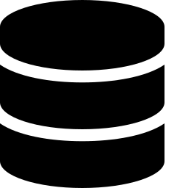




Traditional Processing vs. Data Locality
Traditional Processing
Data Locality Approach
Large Data
Large Data
Stored on Node 5
Transfer to CPU
Program moves to Node 5
Processing
Local Processing
Problem
Huge network traffic · Slow processing
No large file transfer required.

Slide 16

Why Is Data Locality Important?
Copying the file first
Editing where it already is
Imagine copying a 200 GB movie from one laptop to another laptop before you can even start editing it.
Instead, edit the movie directly on the laptop where the file already exists — no transfer at all.
Very slow — the transfer itself can take longer than the actual editing work.
Much faster — this is exactly what Data Locality does for Big Data processing.

Slide 17

Types of Data Locality
Not all locality is equal — performance depends on how far the data must travel.
1. Node Local
2. Rack Local
3. Remote Rack
Data and processing run on the exact same machine.
Processing occurs on a different machine within the same rack.
Data must travel across racks to reach the processing machine.
Best performance
Slightly slower
Slowest option

Slide 18
Data Locality Hierarchy
Performance drops the further data must travel from the processing task
Node Local
Best Performance
Rack Local
Moderate Performance
Remote Rack
Worst Performance

Slide 19



Advantages
Faster execution
Less network traffic
Better throughput
Lower latency
Higher cluster efficiency

Slide 20


Real-World Examples
YouTube
Google Maps
Videos are stored in regional data centers around the world.
Map data is cached in nearby regional servers close to users.
Users watch videos from the nearest server. Instead of transferring videos worldwide, content is served locally.
Users receive responses quickly because the data is stored close to them.

Slide 21

INDUSTRY EXAMPLE
Hadoop MapReduce
Hadoop MapReduce schedules tasks on the DataNode that already contains the required data block.
This minimizes network usage by keeping the computation as close as possible to the data it needs — the scheduler always prefers Node Local, then Rack Local, before falling back to Remote Rack.

Slide 22

Classroom Activity
Think about it:
You have a 500 GB file. Would you:
A) Move the file to another computer?
B) Move the program to the computer storing the file?
Discuss in pairs — justify your answer using the Data Locality Hierarchy from this chapter.
Exam-Oriented Points to Remember
Data Locality = executing computation where the data already resides
Three types: Node Local (best), Rack Local, Remote Rack (worst)
Hadoop MapReduce always prefers Node Local scheduling first

Slide 23
Defining Apache Hadoop
FORMAL DEFINITION
Apache Hadoop is an open-source framework developed by the Apache Software Foundation for storing and processing extremely large datasets across a cluster of interconnected computers using distributed storage and parallel processing.
SIMPLE DEFINITION
Hadoop is a software framework that stores huge amounts of data across many computers and processes that data in parallel, making Big Data processing faster, reliable, and scalable.
Unlike traditional systems that store data on a single server, Hadoop distributes data across multiple nodes and processes it simultaneously.

Slide 24
Key Characteristics of Hadoop
✓
✓
✓
Open-source framework
Designed for Big Data
Stores data across multiple computers
✓
✓
✓
Supports parallel processing
Highly scalable
Fault tolerant
✓
Cost-effective (commodity hardware)

Slide 25
The Problems Hadoop Had to Solve
As internet usage grew, companies like Google, Facebook, Amazon, and Yahoo generated enormous data daily — traditional single-server systems could not keep up with storage, processing speed, hardware failure, or scalability demands.
TRADITIONAL SYSTEM
PROBLEM
Single server
Limited storage capacity
Vertical scaling
Expensive hardware upgrades
Single point of failure
Entire system may stop
Sequential processing
Slow performance
Difficult scalability
Adding resources is costly

Slide 26
How Hadoop Solves These Problems
PROBLEM
HADOOP SOLUTION
Huge data
Distributed storage (HDFS)
Slow processing
Parallel processing (MapReduce)
Hardware failure
Replication and fault tolerance
Scalability
Add more DataNodes
High cost
Commodity hardware

Slide 27
Traditional System vs. Hadoop, Side by Side
TRADITIONAL SYSTEM
HADOOP
Large Data
Large Data
Single Server
Distributed Cluster
Storage Full
Multiple DataNodes
Slow Processing
Parallel Processing
System Failure
Fast & Reliable

Slide 28
Features of Hadoop (1/2)
Features are the characteristics that make Hadoop suitable for processing Big Data.
1
Distributed Storage
2
Parallel Processing
Data is divided into blocks and stored across multiple computers using HDFS.
Many computers process different portions of the data simultaneously.
Benefit: Unlimited storage expansion
Benefit: Significantly faster execution
3
Scalability
4
Fault Tolerance
Additional computers can be added without interrupting the system.
Multiple replicas of data are maintained — if one server fails, another replica is used automatically.
Benefit: Handles increasing data volumes efficiently
Benefit: Improved reliability and availability

Slide 29
Features of Hadoop (2/2)
5
6
7
High Throughput
Cost Effective
Flexibility
Optimized for large volumes of data rather than individual transactions.
Runs on inexpensive commodity hardware.
Supports structured, semi-structured, and unstructured data
Benefit: Efficient batch analytics
Benefit: Lower infrastructure cost
Benefit: Handles any data type
CLASSROOM ACTIVITY
Which Hadoop feature ensures data remains available even if one DataNode fails?
Expected answer: Fault Tolerance through Replication.

Slide 30
HDFS (Hadoop Distributed File System)
It stores large files by breaking them into blocks (default 128 MB) and distributing them across multiple low-cost machines.
HDFS ensures fault-tolerance by keeping copies of data blocks on different machines. This makes it reliable, scalable and ideal for handling big data efficiently.
Features of HDFS
  Easy to access the files stored in HDFS.
  High availability and fault tolerance.
  Provides scalability to scaleup or scaledown nodes as per our requirement.
  Data is stored in distributed manner i.e. various Datanodes are responsible for storing the data.
  HDFS provides Replication because of which no fear of Data Loss.
  HDFS Provides High Reliability as it can store data in a large range of Petabytes.
  HDFS has in-built servers in Name node and Data Node that helps them to easily retrieve the cluster information.
  Provides high throughput.

Slide 31
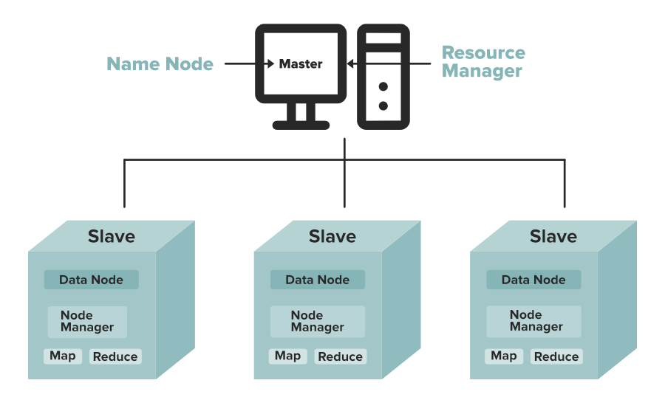
HDFS (Hadoop Distributed File System)
Hadoop follows a master-slave architecture using the MapReduce algorithm.

Slide 32
HDFS (Hadoop Distributed File System)
1. NameNode (Master):
The NameNode acts as the master of the Hadoop cluster.
It is responsible for storing metadata — data about the actual data.
This includes information like:
  File names
  File sizes
  Block numbers and IDs
  Locations of blocks stored in DataNodes
The NameNode manages and monitors the DataNodes and sends them instructions to create, delete or replicate data blocks.
It also receives regular heartbeat signals and block reports from the DataNodes to ensure everything is functioning properly.
Since NameNode controls entire cluster, it requires high RAM and processing power to manage system efficiently.

Slide 33
HDFS (Hadoop Distributed File System)
2. DataNode (Slave):
The DataNodes act as slaves and are responsible for storing actual data blocks in Hadoop cluster.
Have dozens or even hundreds of DataNodes and more DataNodes mean more storage capacity.
Each DataNode performs tasks like creating, deleting or replicating data blocks all based on the instructions received from the NameNode.
To store large files efficiently, DataNodes should have a high storage capacity.

Slide 34
HDFS (Hadoop Distributed File System)
Secondary Name Node (SNN) :
  It acts as a helper node that periodically merges the primary NameNode's filesystem image (fsimage) with the transaction log (edit log).
  It is not a failover or backup node for the primary NameNode if it crashes. Its main job is to prevent the edit log from growing too large, which reduces the primary NameNode's restart time.
Job Tracker
  It is the master service for MapReduce execution in a Hadoop cluster.
  It accepts data processing jobs from clients, divides them into individual tasks, and assigns those tasks to slave nodes running Task Trackers, while tracking overall progress and handling faults.
Task Tracker
  It is the slave daemon that runs on each worker node in the cluster to execute individual Map and Reduce tasks assigned by the Job Tracker.
  It communicates status updates and sends regular heartbeat signals back to the Job Tracker to report available processing slots and task progress.

Slide 35
Hadoop Distributed File System – Write Operations
The write path involves breaking data into packets and streaming them through a pipeline of DataNodes.
Client requests file creation: The client calls create() on the DistributedFileSystem.
NameNode Validates request: It checks permissions and verifies the file path.
Stream initialization: The file system returns an FSDataOutputStream to the client.
Data buffering: The client splits data into packets within an internal queue.
Block allocation: The NameNode selects a pipeline of suitable DataNodes.
Pipeline streaming: The client streams packets to the first DataNode.
Downstream replication: The first DataNode forwards packets to the next.
Acknowledgment loop: DataNodes send success packets back via an ack queue.
Stream closure: The client invokes close() after finishing all blocks.
Final acknowledgment: The NameNode confirms file completion.

Slide 36
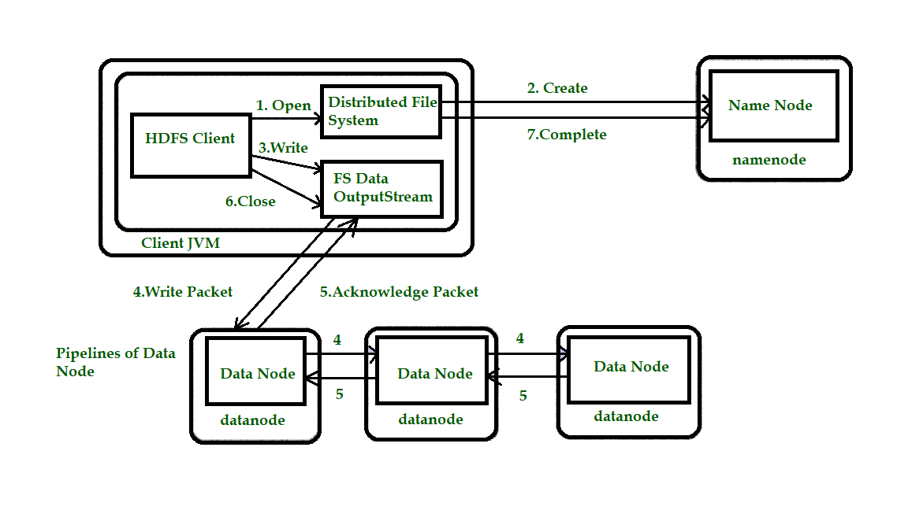
Hadoop Distributed File System – Write Operations

Slide 37
Hadoop Distributed File System – Read Operations
The read path prioritizes data proximity by connecting the client directly to the closest available DataNode.
Client opens file: The client initiates the call using open().
Metadata retrieval: DistributedFileSystem contacts the NameNode for block locations.
DataNode sorting: The NameNode ranks target DataNodes by physical proximity.
Stream return: The client receives an input stream called FSDataInputStream.
Node connection: The client connects to the closest hosting DataNode.
Data streaming: The client invokes read() to stream block data.
Sequential transition: The stream automatically switches to the next block.
Resource cleanup: The client invokes close() when reading concludes.

Slide 38
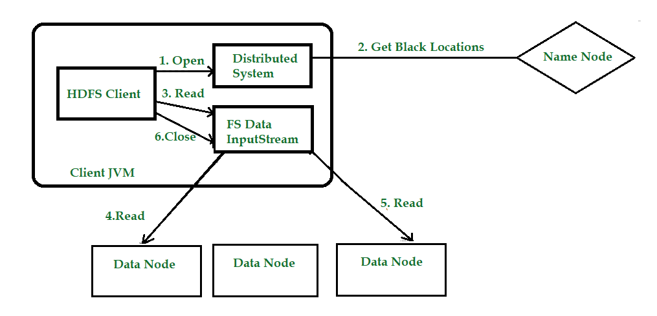
Hadoop Distributed File System – Read Operations

Slide 39
Block Management and Data Partitioning in HDFS
Block management in HDFS (Hadoop Distributed File System) is the core mechanism by which the Apache Hadoop master node (NameNode) tracks, organizes, and maintains the physical data chunks distributed across worker nodes (DataNodes).
The process of splitting a dataset into more manageable, smaller pieces in order to improve efficiency, scalability, and performance is known as data partitioning.
It can be accomplished by either vertical partitioning, which separates data into columns, or horizontal partitioning, which divides data into rows according to particular criteria.
This method is especially helpful in databases, big data processing frameworks, and machine learning applications since it enables quicker query execution, simpler management of massive datasets, and better resource use.

Slide 40
Data Partitioning in HDFS
Some real-world examples of data partitioning are:
  E-commerce Platforms: Customer data is partitioned by region (e.g., North America, Europe) to optimize shipping, inventory, and localized marketing, improving performance and user experience.
  Banking and Finance: Transaction data is partitioned by account type or date (e.g., daily) for faster processing, reporting, and more efficient fraud detection.
  Social Media: User data is split by demographics or interests to enable targeted ads and content, enhancing relevance and system efficiency.

Slide 41
Data Partitioning in HDFS
Importance:
Data partitioning is essential for several reasons:
  Performance Improvement: By breaking data into smaller segments, systems can access only the relevant partitions, leading to faster query execution and reduced load times.
  Scalability: As datasets grow, partitioning allows for easier management and distribution across multiple servers or storage systems, enabling horizontal scaling.
  Efficient Resource Utilization: It helps optimize the use of resources by allowing systems to focus processing power on specific partitions rather than the entire dataset.
  Enhanced Manageability: Smaller partitions are easier to back up, restore, and maintain, facilitating better data governance and maintenance practices.

Slide 42
Methods of Data Partitioning
Horizontal Partitioning/Sharding
Vertical Partitioning
Key-based Partitioning
Range Partitioning
Hash-based Partitioning

Slide 43
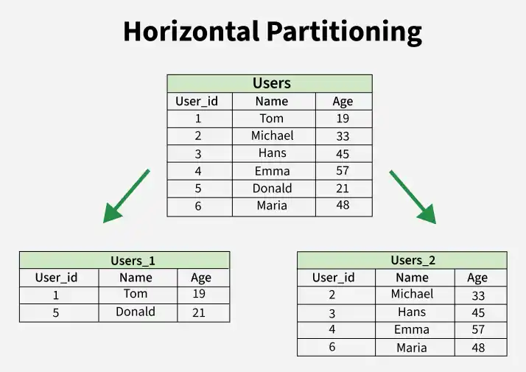
Horizontal Partitioning/Sharding
Horizontal Partitioning divides data by rows, but all partitions may still exist on the same server.
When these horizontal partitions are placed across multiple servers, the approach is called Sharding.
Sharding is a special case of horizontal partitioning that provides true horizontal scalability and high availability by distributing partitions across multiple machines.

Slide 44
Horizontal Partitioning/Sharding
Advantages
Horizontal partitioning divides a table into multiple parts by distributing rows across different partitions or servers.
  Scalability: Allows parallel processing of large datasets across multiple nodes.
  Load Balancing: Distributes workload evenly, reducing system bottlenecks.
  Fault Tolerance: Each partition works independently, improving reliability during failures.
Disadvantages
Despite its scalability benefits, it introduces some complexity in database operations.
  Complex Joins: Joins across multiple partitions can be slower and harder to manage.
  Data Skew: Uneven data distribution may cause certain partitions to handle more load than others.

Slide 45
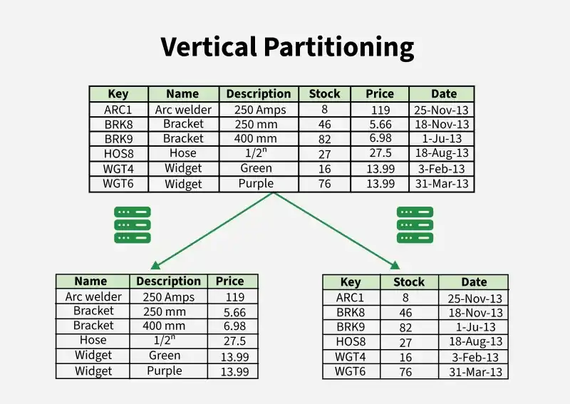
Vertical Partitioning
Vertical partitioning divides a dataset based on columns (attributes) instead of rows.
Each partition contains only a subset of columns for all rows, depending on access patterns.
It is useful when different columns are accessed more frequently or independently.

Slide 46
Vertical Partitioning
Advantages
Vertical partitioning divides a table by separating columns into different partitions based on usage or functionality.
  Better Query Performance: Reduces data read by isolating frequently accessed columns.
  Efficient Retrieval: Fetches only needed columns, saving I/O and storage.
  Easier Schema Changes: Simplifies adding or removing columns.
Disadvantages
Although useful for column-level optimization, it can introduce additional query complexity.
  Query Complexity: Queries may need to access multiple partitions.
  Slower Joins: Combining data from different partitions adds overhead.
  Limited Scalability: Not ideal for datasets with rapidly growing columns.

Slide 47
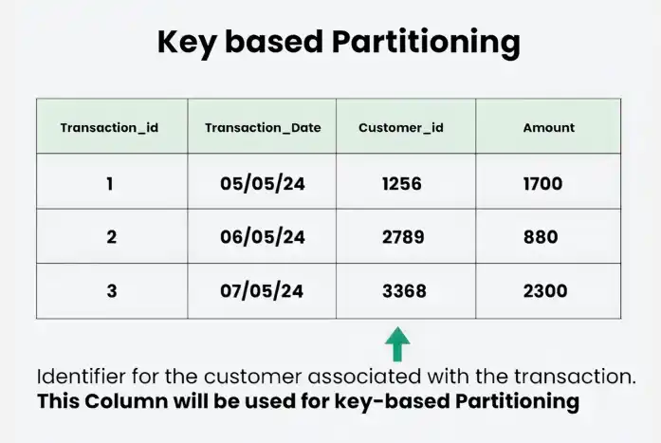
Key-based Partitioning
Divides data based on a specific key or attribute, with each partition holding all data related to that key. Common in distributed systems for uniform data distribution and efficient key-based lookups.

Slide 48
Key-based Partitioning
Advantages :
Key-based partitioning distributes data across partitions using a specific key, usually through a hashing mechanism.
  Even Distribution: Stores data with the same key together for efficient lookups.
  Scalability: Enables parallel processing across partitions.
  Load Balancing: Distributes workload to avoid performance bottlenecks.
Disadvantages :
Improper key selection can lead to uneven workloads and performance issues.
  Data Skew: Uneven key access can create hotspots.
  Limited Flexibility: Less efficient for range or multi-key queries.
  Partition Overhead: Requires careful management as data or key patterns evolve.

Slide 49
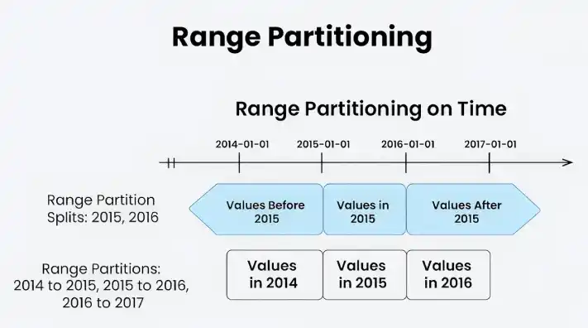
Range Partitioning
The dataset is divided using range partitioning based on a preset range of values.
For example, if your dataset has timestamps, you can divide it according to a specific time range.
Range partitioning might be useful when you have data with natural ordering and wish to distribute it evenly based on the range of values.

Slide 50
Range Partitioning
Advantages
Range partitioning divides data into partitions based on specific value ranges such as dates, IDs, or numbers.
  Natural Ordering: Ideal for data with an inherent range-based structure.
  Efficient Range Queries: Quickly locates data within specified value ranges.
  Simplified Query Planning: System easily identifies relevant partitions for range conditions.
Disadvantages
Improper range design can lead to uneven data distribution and management challenges.
  Data Skew: Uneven data across ranges can affect performance.
  Growth Management: Adding or adjusting ranges requires ongoing maintenance.
  Complex Joins: Joins and non-contiguous range queries can be slower and harder to manage.

Slide 51
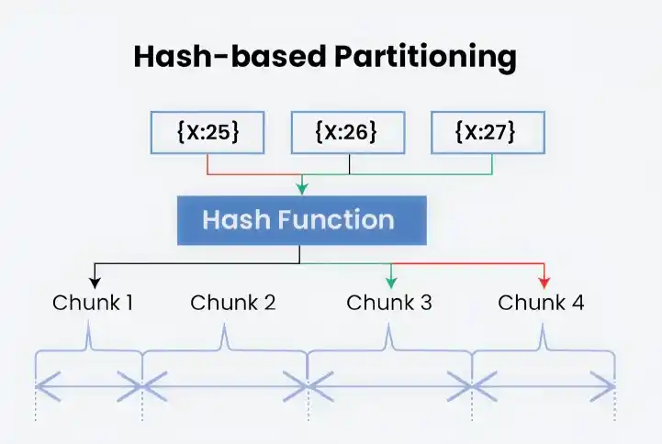
Hash-based Partitioning
Hash partitioning uses a hash function to map data into different partitions.
The hash value determines which partition the data belongs to, enabling even distribution and faster lookup.
It helps with load balancing by spreading data randomly across partitions and improves data retrieval performance by reducing hotspots.
CREATE TABLE employees (id INT NOT NULL, fname VARCHAR(30), lname VARCHAR(30), hired DATE NOT NULL DEFAULT '1970-01-01', separated DATE NOT NULL DEFAULT '9999-12-31', job_code INT, store_id INT) PARTITION BY HASH(store_id) PARTITIONS 4;

Slide 52
Hash-based Partitioning
Advantages
Hash-based partitioning distributes data across partitions using a hash function applied to a specific key.
  Even Distribution: Randomized hashing spreads data uniformly across partitions.
  Scalability: Supports parallel processing across multiple nodes.
  Simplicity: Easy to implement and doesn’t rely on data order.
Disadvantages
Although effective for distribution, it can introduce limitations in query flexibility.
  Inefficient Lookups: Poor performance for key-based or range queries.
  Possible Imbalances: Hashing may not always ensure perfect load distribution.
  Maintenance Overhead: Scaling may require repartitioning and rehashing data.

Slide 53
NoSQL Models
NoSQL databases are classified into different types based on the way they store and organize data.
Each type is designed to handle specific data structures and application requirements, offering different advantages in terms of scalability, performance and data access.
There are four main types of NoSQL databases:
  Key-Value Database
  Document Database
  Column-Family Database
  Graph Database

Slide 54
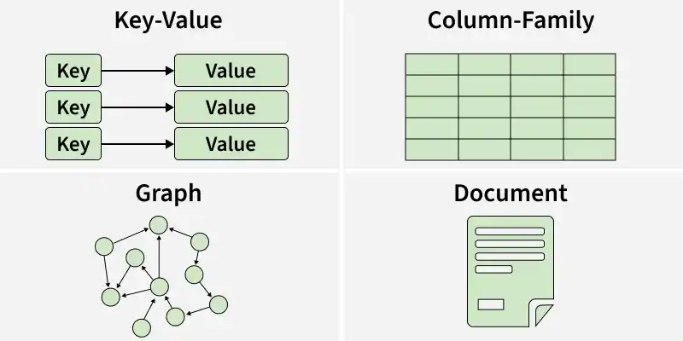
NoSQL Models

Slide 55
Document Databases in NoSQL
It stores data in the form of documents instead of rows and columns.
Documents are usually stored in formats such as JSON, BSON or XML, making them flexible and easy to manage.
Supports flexible and dynamic schemas.
Documents can contain nested data and complex structures.
Designed for high scalability and fast data retrieval.
Popular Document Databases
  MongoDB
  CouchDB
  Amazon DocumentDB
  Azure Cosmos DB

Slide 56
Components of a Document Data Model
Document :
  A document is the basic unit of data storage. It contains related information organized as key-value pairs.
  Example:
      {
      "_id": 101,
      "name": "John",
      "age": 25,
      "city": "Delhi"
      }

Slide 57
Components of a Document Data Model
Fields :
  Fields are individual attributes within a document. Each field consists of a field name and a corresponding value.
Example:
Field Value
name John
age 25
city Delhi

Slide 58
Components of a Document Data Model
Collection
  A collection is a group of related documents. It is similar to a table in a relational database but does not require a fixed schema.
  Example:
    Users Collection
        [
        {
        "_id": 101,
        "name": "John",
        "age": 25
        },
        {
        "_id": 102,
        "name": "Alice",
        "age": 30
        }
        ]

Slide 59
Components of a Document Data Model
Embedded Documents
  A document can contain another document within it, allowing related data to be stored together.
  Example:
    {
    "_id": 101,
    "name": "John",
    "address": {
    "city": "Delhi",
    "pincode": 110001
    }
    }

Slide 60
Example of a Document Database in NoSQL
Employee Document (JSON Format):
{
"employee_id": 101,
"name": "John Smith",
"department": "IT",
"address": {
"city": "New York",
"country": "USA"
},
"projects": [
{
"project_id": 1,
"project_name": "Website Development"
},
{
"project_id": 2,
"project_name": "Mobile App"
}
]
}

Slide 61
Document Database in NoSQL
Advantages of Document Database Model
  Flexible Schema: Documents can have different fields and structures without affecting other documents.
  Easy Data Representation: Complex and nested data can be stored naturally within a single document.
  High Scalability: Data can be distributed across multiple servers to support large-scale applications.
  Fast Data Access: Documents can be retrieved quickly without requiring complex joins.
  Developer Friendly: JSON-like document formats are easy to understand and work with in modern applications.
Limitations of Document Database Model
  Data Redundancy: Similar information may be repeated across multiple documents, increasing storage usage.
  Complex Relationships: Managing relationships between documents can be more difficult than in relational databases.
  Limited Join Support: Most document databases provide limited or less efficient join operations.

Slide 62
Key-Value Data Model in NoSQL
A key-value database is a type of NoSQL database that stores data as key-value pairs. Each key acts as a unique identifier and is associated with a single value.
  Uses simple data storage architecture.
  Handles large volumes of distributed data efficiently.
  Commonly used in high-performance applications.
Components of a Key-Value Data Model:
  Key :
    A unique identifier used to access a specific piece of data. The database uses the key to quickly find the associated value without scanning all records.
  Value
    The data associated with the key, which can be a string, number, JSON object, image or any other data type. The structure of the value is flexible, allowing applications to store data in various formats based on their requirements.

Slide 63
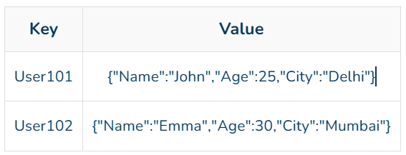
Key-Value Data Model in NoSQL
Key-Value Pair
  The combination of a key and its corresponding value. Data is inserted, updated and retrieved using these key-value pairs.
Example:
Databases
Couchbase: Supports SQL-like querying and text search.
Amazon DynamoDB: Highly scalable and widely used cloud-based key-value database.
Riak: Designed for building distributed applications.
Aerospike: Open-source database optimized for real-time applications.
Berkeley DB: High-performance database with scalability support.

Slide 64
Working of a Key-Value Database
The working of a key-value database is based on storing and retrieving data using unique keys. Each key is associated with a specific value, allowing fast and efficient data access.
Step 1: Store Data as Key-Value Pairs
Step 2: Request Data Using a Key
Step 3: Locate the Key
Step 4: Return the Associated Value
Step 5: Update or Delete Data
Example of Key-Value Data Model
{
"User101": { "Name": "John", "Age": 25, "City": "Delhi"},
"User102": { "Name": "Alice", "Age": 30, "City": "Mumbai"},
"User103": {"Name": "Bob", "Age": 28, "City": "Bangalore"}
}

Slide 65
Uses of a Key-Value Database
Caching
  Key-value databases are used to store frequently accessed data in memory, reducing the need to repeatedly query the main database.
Session Management
  Web applications store user session information as key-value pairs to maintain login states and user preferences.
User Profiles
  User information can be stored and retrieved using a unique user ID as the key.
Shopping Carts
  E-commerce websites use key-value databases to store products added to a user's shopping cart.
Configuration Management
  Application settings and configuration data are often stored as key-value pairs.
IoT Applications
  IoT systems store device information and sensor readings using unique device IDs.

Slide 66
Key-Value Data Model
Advantages of Key Value Model
  Efficient Key-Based Access: Enables rapid data retrieval through unique keys.
  Low-Latency Operations: Provides high-performance read and write operations.
  Horizontal Scalability: Supports data distribution across multiple nodes.
  Schema Flexibility: Allows storage of diverse data types without a predefined schema.
  High Availability: Ensures continuous access to data in distributed environments.
Limitations of Key Value Model
  Limited Query Capabilities: Efficiently supports only key-based lookups, making complex queries difficult.
  No Relationship Support: Does not provide native support for relationships between data entities.
  Data Redundancy: May require duplication of related data across multiple key-value pairs.

Slide 67
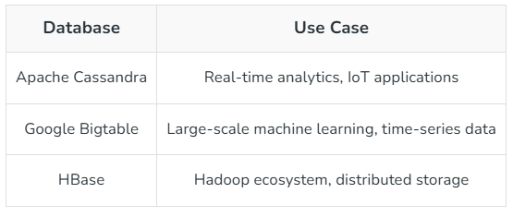
Columnar (Column-Family) Data Model
Columnar databases are those where the data is stored in columns instead of rows as is done in the traditional row-based databases as they offer impressive benefits in certain types of queries and data manipulation operations.
Therefore, databases that are organized in columns provide better performances for operations that require applications to read data such as data analytics and data warehousing.
This approach enhances the rate of query processing and reduces disk I/O making it suitable for cases that involve a large number of queries that are processed on large amounts of data.
Popular Column-Oriented Databases & Use Cases

Slide 68
Columnar Data Model
Advantages of Columnar Database
  Columnar databases can be used for different tasks such as when the applications that are related to big data comes into play then the column-oriented databases have greater attention in such case.
  The data in the columnar database has a highly compressible nature and has different operations like (AVG), (MIN, MAX), which are permitted by the compression.
  Efficiency and Speed: The speed of Analytical queries that are performed is faster in columnar databases.
  Self-indexing: Another benefit of a column-based DBMS is self-indexing, which uses less disk space than a relational database management system containing the same data.
Limitation of Columnar Database
  For loading incremental data, traditional databases are more relevant as compared to column-oriented databases.
  For Online transaction processing (OLTP) applications, Row oriented databases are more appropriate than columnar databases.

Slide 69
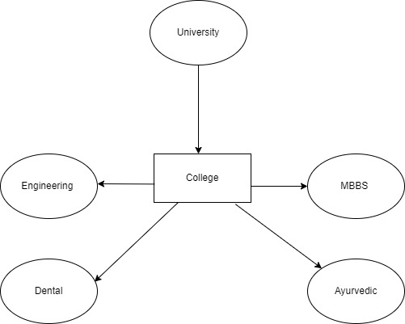
Graph Based Data Model in NoSQL
It tries to focus on building the relationship between data elements.
As the name suggests Graph-Based Data Model, each element here is stored as a node, and the association between these elements is often known as Links.
Association is stored directly as these are the first-class elements of the data model.
These data models give us a conceptual view of the data.
These are the data models which are based on topographical network structure.
  Nodes: These are the instances of data that represent objects which is to be tracked.
  Edges: it represent relationships between nodes.
  Properties: It represents information associated with nodes.

Slide 70
Examples of Graph Data Models :
JanusGraph: It is a scalable graph database system open source too. JanusGraph has different features like:
  Storage: Many options are available for storing graph data like Cassandra.
  Support for transactions: There are many supports available like ACID (Atomicity, Consistency, Isolation, and Durability) which can hold thousands of concurrent users.
  Searching options: Complex searching options are available and optional support too.
Neo4j: It stands for Network Exploration and Optimization 4 Java. As the name suggests this graph database is written in Java with native graph storage and processing. Neo4j has different features like:
  Scalable: Scalable through data partitioning into pieces known as shards.
  Higher Availability: Availability is very much high due to continuous backups and rolling upgrades.
  Query Language: Uses programmer-friendly query language Cypher graph query language.
DGraph: It is an open-source distributed graph database system designed with scalability. DGraph main features are:
  Query Language: It uses GraphQL, which is solely made for APIs.
  Open-source system: support for many open standards.

Slide 71
Graph Data Models :
Advantages of Graph Data Model :
  Structure: The structures are very agile and workable too.
  Explicit Representation: The portrayal of relationships between entities is explicit.
  Real-time O/P Results: Query gives us real-time output results.
Disadvantages of Graph Data Model :
  No standard query language: Since the language depends on the platform that is used so there is no certain standard query language.
  Unprofessional Graphs: Graphs are very unprofessional for transactional-based systems.
  Small User Base: The user base is small which makes it very difficult to get support when running into a system.

Slide 72
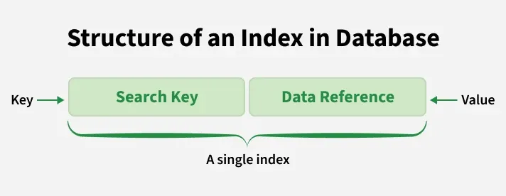
Indexing in Databases
Indexing in databases is a data structure technique used to speed up data retrieval operations by minimizing the number of disk accesses required to locate records.
  Stores copies of selected column (search key) values
  Maintains pointers to the actual data rows in the main table
  Allows faster searching without scanning the entire table

Slide 73
Common Indexing Techniques in Databases
Single-Column Indexing: This works best for improving query speed when filtering or sorting by a single column. Creating an index on a particular column helps the database quickly find and fetch rows that match the values in that column. This method notably boosts the search speed for individual column values.
Composite Indexing: Composite indexing involves creating indexes on multiple columns. It proves particularly advantageous for queries that involve conditions referencing multiple columns simultaneously. By encompassing multiple columns within a single index, composite indexing enhances query efficiency, especially for complex queries requiring filtering or sorting based on multiple criteria.
Covering Indexes: Covering indexes are designed to fulfil query requirements without accessing table data. By including all the columns necessary to satisfy a query within the index itself, covering indexes expedite query execution. This technique eliminates the need for the database system to access the underlying table data, resulting in faster query processing.

Slide 74
Common Indexing Techniques in Databases
Clustered vs. Non-clustered Indexes: Clustered indexes determine the physical order of data within a table, affecting the arrangement of records. The actual data rows are ordered based on the clustered index key.
In contrast, non-clustered indexes are separate structures that reference the table data but do not dictate the physical order of the data. Non-clustered indexes contain pointers to the actual table rows, making them ideal for optimizing specific query types without altering the physical data arrangement.
Indexing Large Datasets (Partitioning and Sharding): When dealing with extensive datasets, partitioning and sharding come into play to spread data across various storage locations or servers. Partitioning breaks down a large table into smaller, more manageable parts based on criteria like range, list, or hash functions.
On the other hand, sharding scatters data across multiple separate databases or servers. Both techniques enhance the efficiency of indexing and query speed by enabling queries to be processed simultaneously across distributed resources. This approach improves scalability and lessens the burden on individual database instances.

Slide 75
Advanced Indexing Techniques in Databases
Indexing for Joins and Aggregations:
  Optimizing index performance for join and aggregation operations involves utilizing various techniques:
    Covering Indexes: Creating indexes that cover all the columns needed for join and aggregation queries to eliminate the need for accessing the base table data.
    Materialized Views: Precomputing and storing the results of complex join or aggregation operations as materialized views to expedite query execution.
    Denormalization: Storing redundant data or aggregations within the database to reduce the need for joins or complex calculations during query execution, enhancing performance for specific use cases.

Slide 76
Advanced Indexing Techniques in Databases
Indexing in NoSQL and NewSQL Databases:
  In NoSQL and NewSQL databases, indexing strategies are tailored to the specific data models and query requirements:
    NoSQL Databases: Indexes in NoSQL databases are designed to cater to flexible data structures, distributed architectures, and varied query patterns prevalent in these databases. Custom indexing techniques are employed to enhance flexibility, scalability, and performance.
    NewSQL Databases (eg. CockroachDB, Google Spanner, VoltDB, etc.): These databases combine elements of traditional SQL databases with scalability features. Indexing strategies in NewSQL databases focus on maintaining ACID compliance while optimizing query performance for distributed environments.

Slide 77
Advanced Indexing Techniques in Databases
Spatial Indexing for Geographic Data:
  Spatial indexing techniques cater specifically to geographic data, enabling efficient retrieval based on spatial relationships like proximity, containment, intersection, etc. Such techniques include:
    R-tree Indexes: Used for indexing multidimensional data, particularly useful for spatial data indexing.
    Geohash Indexing: Encoding geographic coordinates into a string representation to generate indexes that facilitate proximity-based searches.
In-Memory Indexing:
  In-memory databases store data primarily in RAM, necessitating specialized indexing techniques for optimal performance:
    Memory-Optimized Structures: Index structures designed to reside in memory rather than on disk to exploit the speed advantages of memory-resident data.
    Columnar Storage: Storing data in columns instead of rows to improve compression and access efficiency when dealing with in-memory databases.

Slide 78
Distributed Query Execution
Distributed query execution breaks a single data request into smaller tasks. It runs these tasks across multiple computers at the same time. A coordinator node plans the work, sends sub-tasks to worker nodes, and joins the final results to speed up large data operations.
Key Steps in Execution
  Parsing: The system reads your query and checks it for errors.
  Planning: An optimizer creates a map to find where data lives.
  Splitting: The plan breaks into small parts for different workers.
  Running: Each worker handles its local data slice at the same time.
  Merging: The main node gathers partial outputs and builds the final result.

Slide 79
Storage Performance Optimization
Storage performance optimization improves data access speed, reduces latency, and maximizes input/output operations per second (IOPS) through hardware upgrades, configuration tuning, and efficient data management strategies like compression and tiered storage.
Core Performance Metrics
  IOPS: Measures input/output operations handled per second; vital for quick transactional data processing.
  Throughput: Evaluates the volume of data transferred over a specific timeframe (often calculated via block size and IOPS).
  Latency: Quantifies the delay before a data transfer request executes; lower values mean faster application response.

